Slide 1


payXpert
-The Payroll Management System

Slide 2
ABSTRACT:
PayXpert is a Java-based payroll management application integrated with a MySQL database. The system is designed to automate the functionalities of employee management, payroll processing, tax calculation, and financial record tracking. It provides functionalities to add, update, delete, and retrieve detailed employee information with data validation and integrity. The payroll module allows generation of salary records based on employee ID and pay period, automatically calculating net salary by factoring in overtime, deductions, and tax using a dedicated Tax Service. The tax management system enables calculation and storage of tax details based on employee ID and tax year, and supports retrieval of tax records by employee or year. Additionally, the Financial Record Service manages categorized entries (Income, Expense, and Tax Payment) supporting queries by record ID, employee ID, and date. The system is built with modular services and DAO architecture, ensuring scalability, maintainability, and efficient database interactions. Hence serving as a reliable and extensible solution for organizations seeking to simplify their payroll and financial operations with precision and automation.

Slide 3

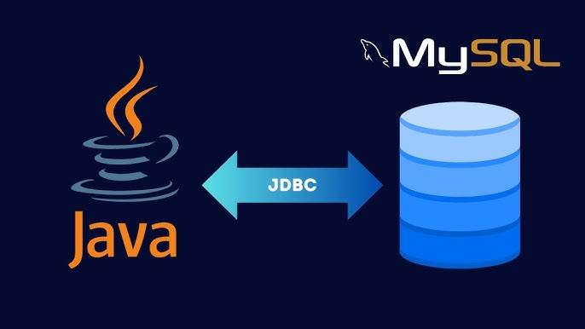


Technology Used:
Backend: JAVA
Database: MySQL
Tools: JDBC, MySQL Workbench, Eclipse IDE
Testing : JUnit

Slide 4
Employee management:
Stores employee data: personal info, contact details, and job-related fields
Enforced unique constraints on Email and Phone Number to maintain data integrity
Validate employee details before insertion or update:
Check for valid email format
Ensure phone number length and pattern
Verify mandatory fields (e.g., First Name, Date of Birth, Gender, Position)
Prevent duplicate entries and ensure clean, consistent records in the database
Supports safe deletion of employees with cascading updates in related tables.
Perform CRUD operations: Add, update, delete, and retrieve employee records

Slide 5
Payroll management:
Generate payroll based on:
Employee ID
Pay Period Start & End Date
Automatically invokes Tax Service to calculate applicable tax deductions
Performs salary breakdown and calculates Net Salary = (Basic + Overtime - Deductions - Tax)
Ensures accuracy by validating input data and employee existence before processing
Stores payroll records securely in the database with foreign key mapping to Employee
Prevents duplication of payroll for the same period and employee
Built for supporting multiple employees and time periods efficiently

Slide 6

Tax management:
Calculates tax using Employee ID and Tax Year
Stores how much income is taxable and how much tax is owed
We can get tax details by Tax ID
Used to show all tax records for a specific employee
Can filter and view taxes by year
Helps check if correct tax was applied
Keeps all tax records organized and easy to access
Makes it simple to track taxes over the years
Supports clean and accurate payroll processing

Slide 7

Financial Record management:
Tracks all money-related activities of employees
Stores records for:
Income
Expense
Tax Payment
Makes it easy to find records by:
Record ID
Employee ID
Record Date
Helps monitor employee-wise financial history
Keeps all financial data organized in one place
Ensures no data is lost or duplicated

Slide 8
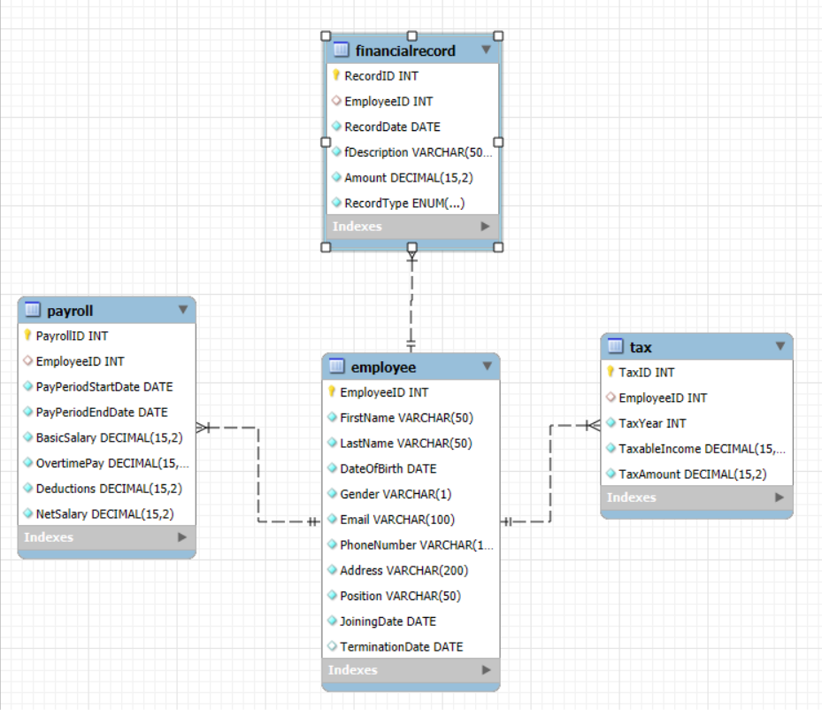
DATABASE Design:

Slide 9
THANK YOU

